Slide 1
Final Project progression
H.J.Kim

Slide 2
Simple Experiment

Slide 3
Staring ‘+’ on the screen
A Korean Word or letter stimuli flashes
After flashing, Target letter shows
Yes or No, the target was in the stimuli

Slide 4
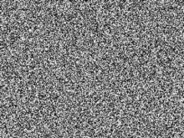
ㄴㅈ
READY?
ㄷㅎ
+

Slide 5
ㄴㅂ
READY?
+
나비

Slide 6
Word Superiority effect
Reicher(1969), context effect in word perception
Accuracy: letter < Word
Top-Down processing in vison
FAST
F
50ms
FAST
F
>

Slide 7
In Korean word condition
Little controversial?
Word Inferiority(Kim & Kim 1997) and Superiority in restricted conditions(Park 1995)
Jeong and Park (2006), Verifying superiority effect in Korean condition

Slide 8
Familiarity and Context
Perceptual feature cannot effect on top-down processing
Seeing word is more familiar situation than single letter(Carrol, 2008)
How about word presented direction?
Vertical direction is less familiar than Horizontal

Slide 9
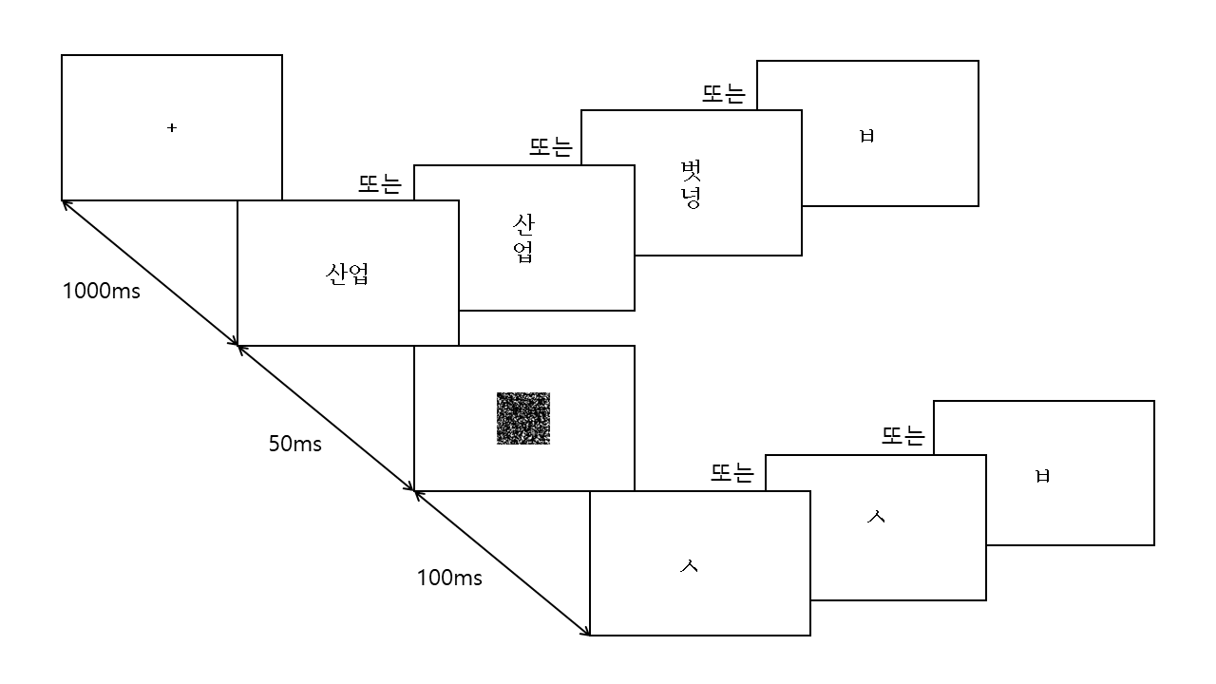
Experiment
23 experiment participants, 240 trials/subject
Jeong & Park (2007) paradigm
Stimulus Conditions
Horizontal Word
Vertical Word
Vertical Non-word
2 Letters

Slide 10
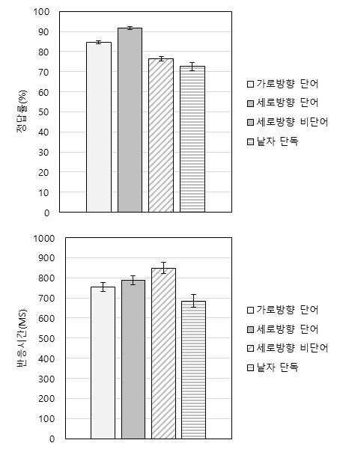
Experiment Results
RT: letter < H-Word < V-Word < V-non word
Accuracy: V-word < H-Word < V-non word < letter

Slide 11
Behavior
24 participants
4 stimulus condition
Horizontal Word
Vertical Word
Vertical Non-word
2 Letters
2 Choices:
Correct
Incorrect

Slide 12
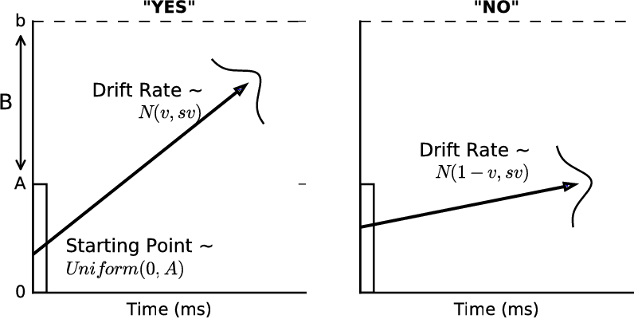
Choice Reaction time model
Linear Ballistic Accumulation model
4 parameters
A : start point
v[i, j] : drift rate i is condition and j is choice
d : Boundary
tau : Non-Decision time
https://www.semanticscholar.org/paper/Diffusion-vs.-linear-ballistic-accumulation%3A-about-Osth Bora/ce5eb4a36a32dad85f3c7ff2f66c0267e08f9a40/figure/2

Slide 13
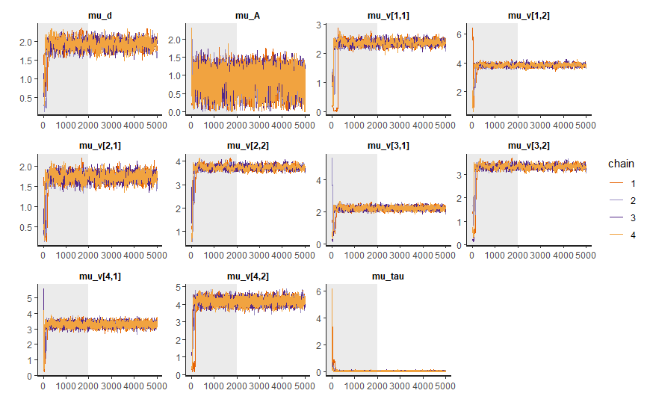
lba_model fit(hBayesDM)
5000 iterations, 2000 warm-up

Slide 14
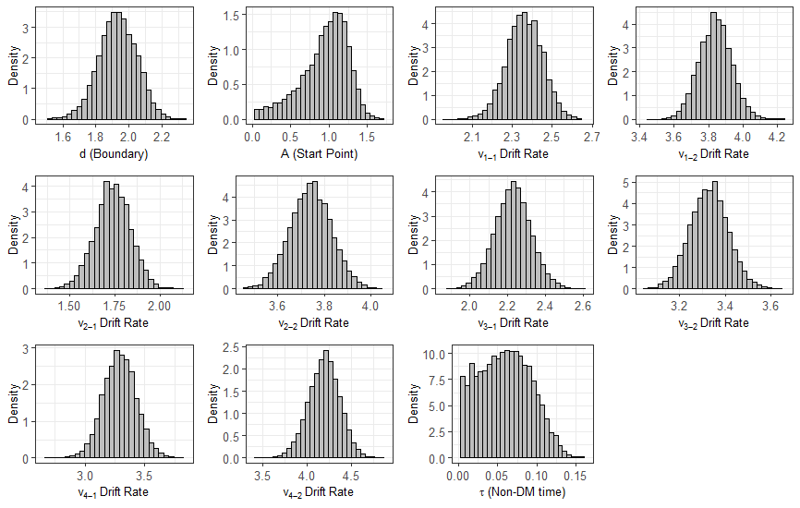
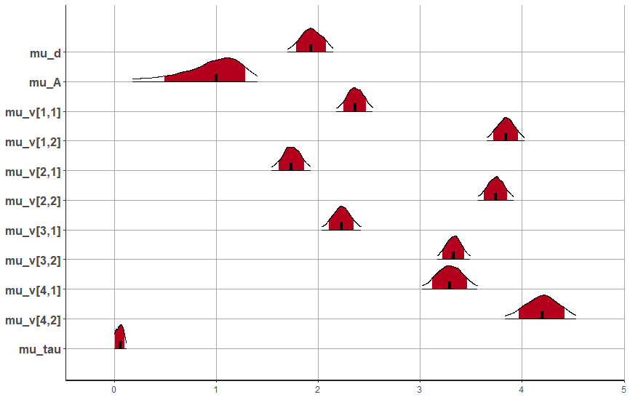
Mu_Posterior distribution

Slide 15
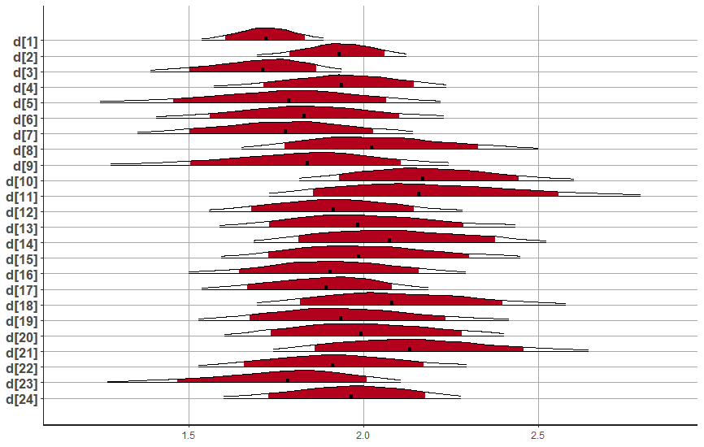
D(Boundary) between subj

Slide 16
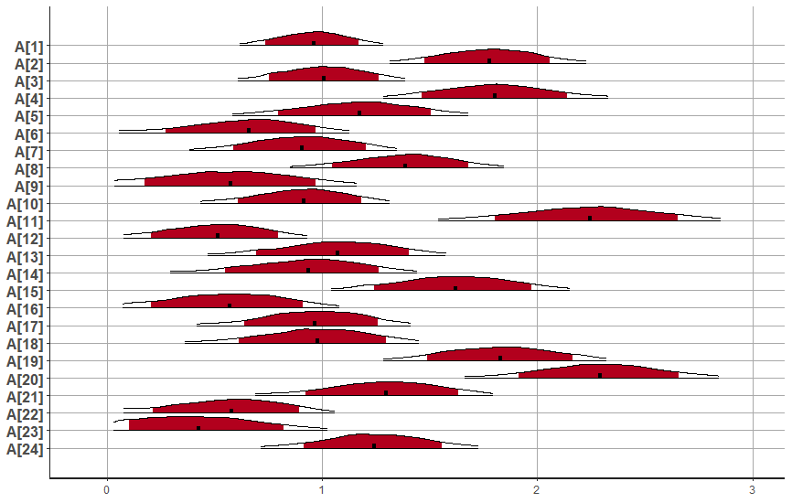
A(start point) between subj
$$Start point=\left[0, A\right], A \sim Uniform(0, A)$$

Slide 17
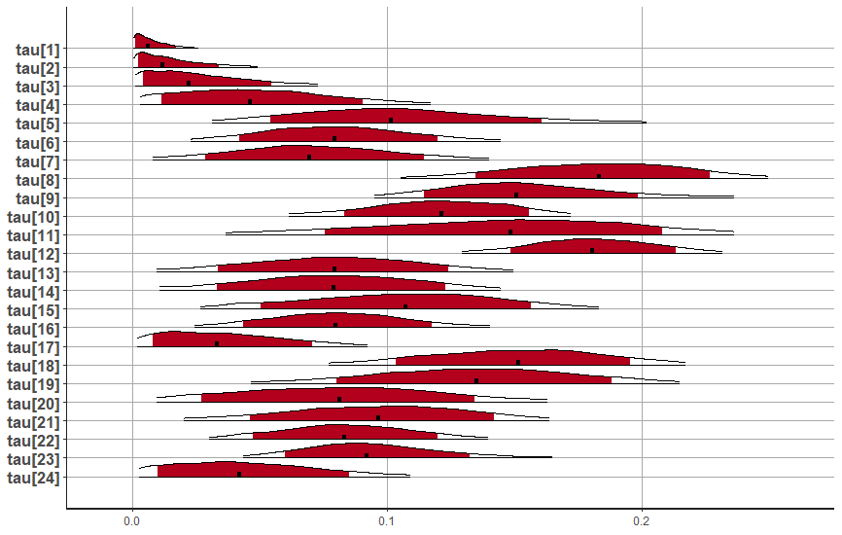
Tau(Non-decision time) between subj

Slide 18
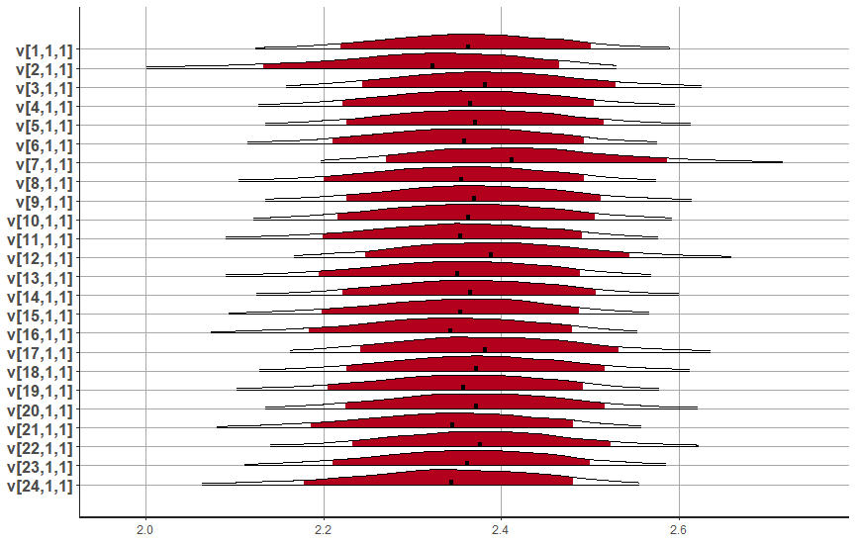

Correct choice drift rate(v) between subj
V[1,1], horizontal word
$$Drift rate \sim Normal(v, std(v))$$

Slide 19
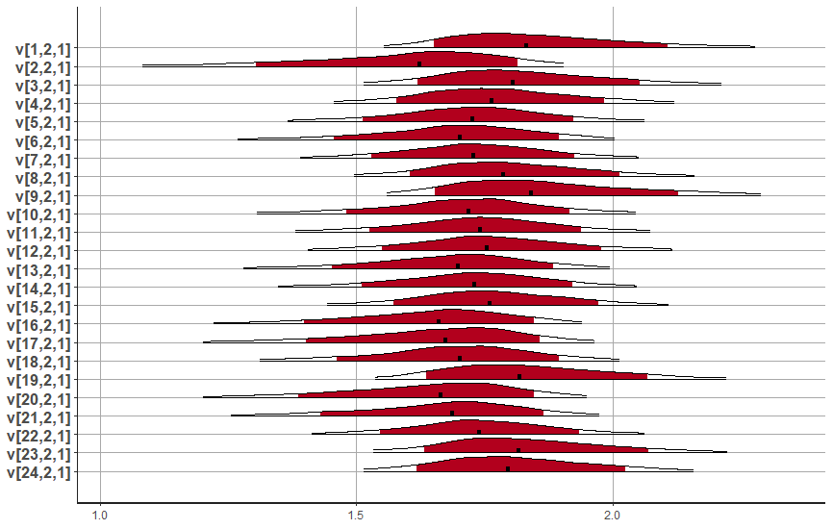
Correct choice drift rate(v) between subj
V[2,1], vertical word
$$Drift rate \sim Normal(v, std(v))$$

Slide 20
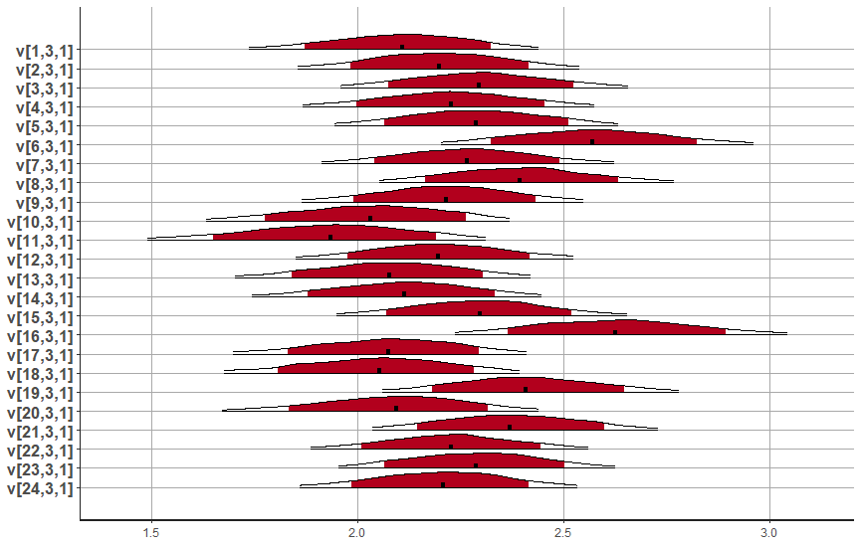
Correct choice drift rate(v) between subj
V[3,1], vertical non-word
$$Drift rate \sim Normal(v, std(v))$$

Slide 21
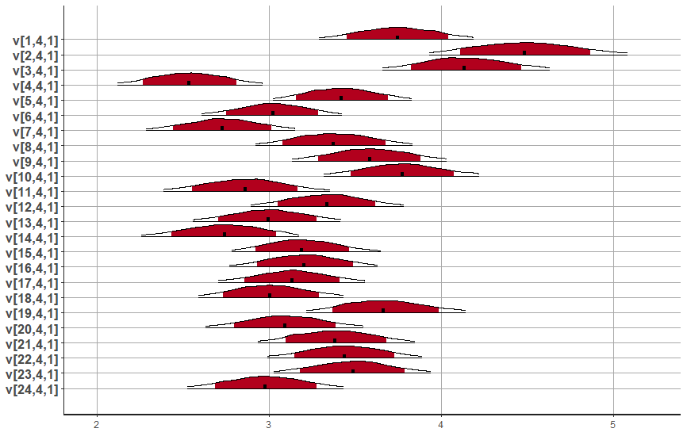
Correct choice drift rate(v) between subj
V[4,1], letters
$$Drift rate \sim Normal(v, std(v))$$

Slide 22
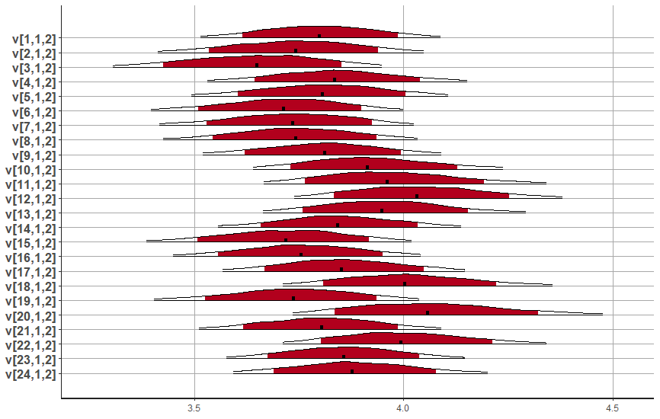

Incorrect choice drift rate(v) between subj
V[1,2], horizontal word
$$Drift rate \sim Normal(1−v, std(v))$$

Slide 23
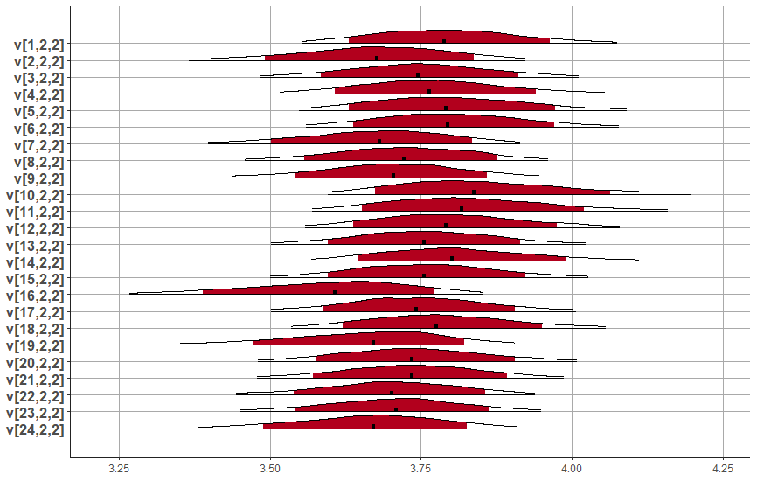
Incorrect choice drift rate(v) between subj
V[2,2], vertical word
$$Drift rate \sim Normal(1−v, std(v))$$

Slide 24
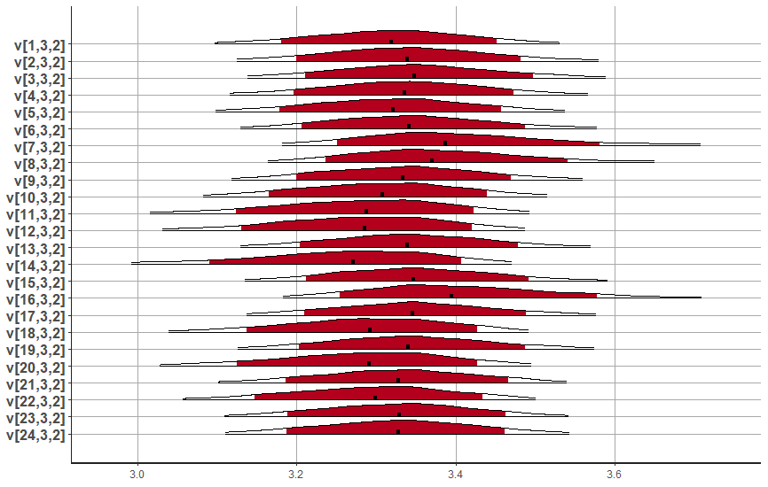
Incorrect choice drift rate(v) between subj
V[3,2], vertical non-word
$$Drift rate \sim Normal(1−v, std(v))$$

Slide 25
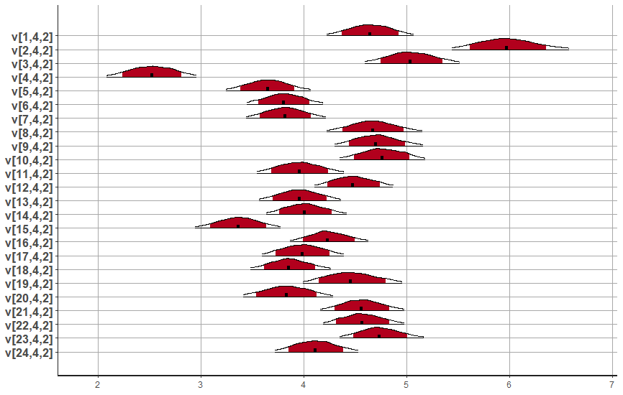
Incorrect choice drift rate(v) between subj
V[4,2], letters
$$Drift rate \sim Normal(1−v, std(v))$$

Slide 26
Discussion
Constant distributions in decision boundary(d) between participants
Decision boundary is similar between participants
Varied distributions in Non-decision time(tau) and Starting point(A) between participants
This reflects individual’s inherent lexicon and motor skills to response.

Slide 27
Discussion
In drift rate(v), sum of correct and incorrect response explains the difference of response time
Data: Letter < H-W < V-W < V-nonW
Sum(v[n,1] and v[n,2]): Letter < H-W < V-nonW <= V-W (Large drift rate reflects faster response)

Slide 28
References
정우현, 박수진 (2006). 한글 낱자 지각에서의 단어 및 글자 우월효과, 한국심리학회지: 인지 및 생물, 18(2), 139-156.
정우현, 박수진 (2007). 한글의 시각적 동일성과 친숙성에 따른 단어 우월 효과, 인지과학, 18(1), 15-34.
Carroll, D. W. (2008). 언어심리학, 박학사.

